Slide 1



Pizza Sales Analysis
Presented by
by Harshita

Slide 2
PROJECT OVERVIEW
This project focuses on analysing pizza sales data using MYSQL to understand customers purchasing behaviour and overall business performances . The analysis focuses on identifying key performance indicators such as total orders, total revenue, best-selling pizzas, sales by category and size, and peak ordering periods. These insights help in understanding customer preferences , demand patterns, and sales trends overtime.
Overall this pizza sales analysis demonstrates the practical application of MYSQL in real-world business scenarios. The result of this project can help pizza business improve menu planning, optimize pricing strategies, manage inventory effectively, and enhance customer satisfaction by making data-driven decisions.

Slide 3
DATASET OVERVIEW
THE PROJECT USES 4 RELATIONAL TABLES STRUCTURED AS:-
pizza_types – pizza names, categories, ingredients
pizzas – size, type, and price
orders – order timestamps
order-details – quantities per order item

Slide 4

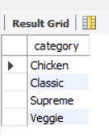
List all the unique pizza category
QUERY:-
SELECT DISTINCT category FROM pizza_types;

Slide 5
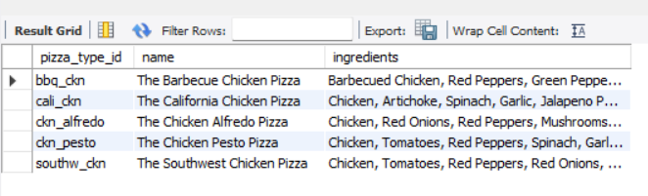
DISPLAY pizza_type_id, name and ingredients, replacing null ingredients with “Missing Data”. Show first 5 rows
QUERY:-
SELECT pizza_type_id, name, COALESCE(ingredients, 'Missing Data') AS ingredients FROM pizza_types LIMIT 5;

Slide 6
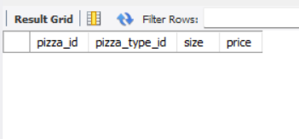
Check for pizzas if missing a price
QUERY:-
SELECT *FROM pizzas WHERE price IS NULL;

Slide 7
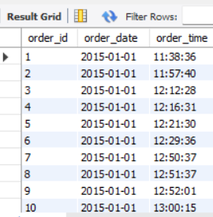
Orders placed on “2015-01-01”
QUERY:-
select * from orders where order_date="2015-01-01";

Slide 8

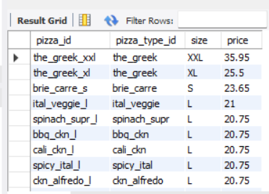
List pizzas with price descending
QUERY:-
SELECT * FROM pizzas ORDER BY price DESC;

Slide 9
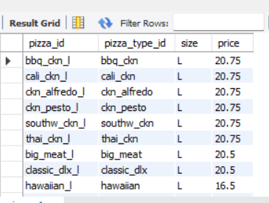
Pizzas sold in size ”L” or “XL”
QUERY:-
SELECT * FROM pizzas WHERE size = 'L' OR size = 'XL';

Slide 10
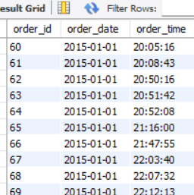
Orders placed on “2015-02-15” or placed after 8 PM
QUERY:-
select * from orders where order_date="2015-01-15" or order_time>"20:00:00";

Slide 11
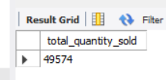
Total quantity of pizzas sold
QUERY:-
SELECT SUM(quantity)FROM order_details;

Slide 12

Average pizza price
QUERY:-
SELECT AVG(price) FROM pizzas;

Slide 13
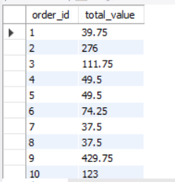
Total order value per order
QUERY:-
SELECT o.order_id, SUM(p.price * od.quantity) AS total_value FROM orders AS o JOIN order_details AS od ON o.order_id = od.order_id JOIN pizzas AS p ON od.pizza_id = p.pizza_id GROUP BY o.order_id;

Slide 14
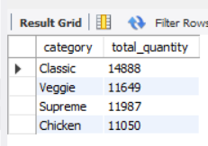
Total quantity sold per pizza category
QUERY:-
SELECT pt.category, SUM(od.quantity) AS total_quantity FROM pizza_types AS pt JOIN pizzas AS p ON pt.pizza_type_id = p.pizza_type_id JOIN order_details AS od ON p.pizza_id = od.pizza_id GROUP BY pt.category;

Slide 15
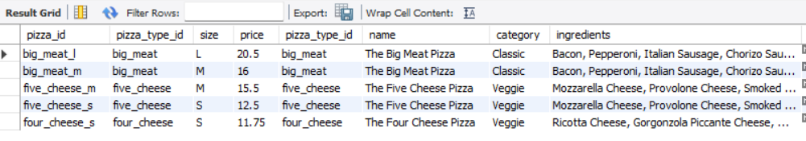
Pizza never ordered
QUERY:-
SELECT *FROM pizzas AS p LEFT JOIN pizza_types AS pt ON p.pizza_type_id = pt.pizza_type_id LEFT JOIN order_details AS od ON p.pizza_id = od.pizza_id WHERE od.order_id IS NULL;

Slide 16

Pizza category that generates the highest revenue
QUERY:-
SELECT pt.category, SUM(p.price * od.quantity) AS total_revenue FROM order_details AS od JOIN pizzas AS p ON od.pizza_id = p.pizza_id JOIN pizza_types AS pt ON p.pizza_type_id = pt.pizza_type_id GROUP BY pt.category ORDER BY total_revenue DESC LIMIT 1;

Slide 17
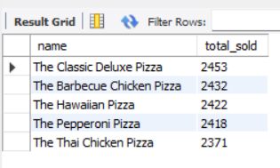
Top 5 best selling pizzas by their total quantities sold
QUERY:-
SELECT pt.name, SUM(od.quantity) AS total_sold FROM order_details AS od JOIN pizzas AS p ON od.pizza_id = p.pizza_id JOIN pizza_types AS pt ON p.pizza_type_id = pt.pizza_type_id GROUP BY pt.name ORDER BY total_sold DESC LIMIT 5;

Slide 18
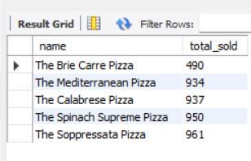
Least Ordered Pizzas
QUERY:-
SELECT pt.name, SUM(od.quantity) AS total_sold FROM order_details AS od JOIN pizzas AS p ON od.pizza_id = p.pizza_id JOIN pizza_types AS pt ON p.pizza_type_id = pt.pizza_type_id GROUP BY pt.name ORDER BY total_sold ASC LIMIT 5;

Slide 19
INSIGHTS
The Greek XXL is the highest-priced pizza in the dataset, with a price of $35.95, indicating that larger pizza sizes are positioned at a premium price.
The analysis of orders placed on 1 January 2015 shows that the business received a significant number of orders throughout the day, reflecting active customer ordering on that date.
The price validation query returned no pizzas with a NULL price, indicating that the pizza pricing data is complete for the records analysed.
The COALESCE() function was used to handle missing ingredient information by replacing missing values with "MISSING DATA", making the dataset easier to interpret and analyse.
The dataset contains four major pizza categories: Chicken, Classic, Supreme, and Veggie, providing a diverse range of products for different customer preferences.
The total quantity sold across the available order details is 49,574 pizza units, showing strong overall sales volume during the analysed period.
The analysis of L and XL pizzas helps identify the availability and pricing of larger pizza sizes, which can be useful for understanding customer preferences for bigger portions.

Slide 20
INSIGHTS
The order-value analysis calculates the total value of each order by combining pizza price and quantity, helping measure the monetary contribution of individual customer orders.
The Classic Deluxe Pizza is the best-selling pizza, with 2,453 units sold, making it the strongest-performing individual pizza in the analysis.
Barbecue Chicken, Hawaiian, Pepperoni, and Thai Chicken also appear among the top five best-selling pizzas, showing that customers have strong demand for both classic and chicken-based options.
The Brie Carre Pizza recorded 490 units sold among the five pizzas shown in the lowest-sales query, suggesting comparatively lower demand and a possible opportunity to review its pricing, promotion, or customer appeal.
The Classic category generated the highest revenue among the categories shown in the analysis, with approximately $220,053.10, indicating that Classic pizzas are an important contributor to overall business revenue.

Slide 21

THANK YOU

